Slide 1
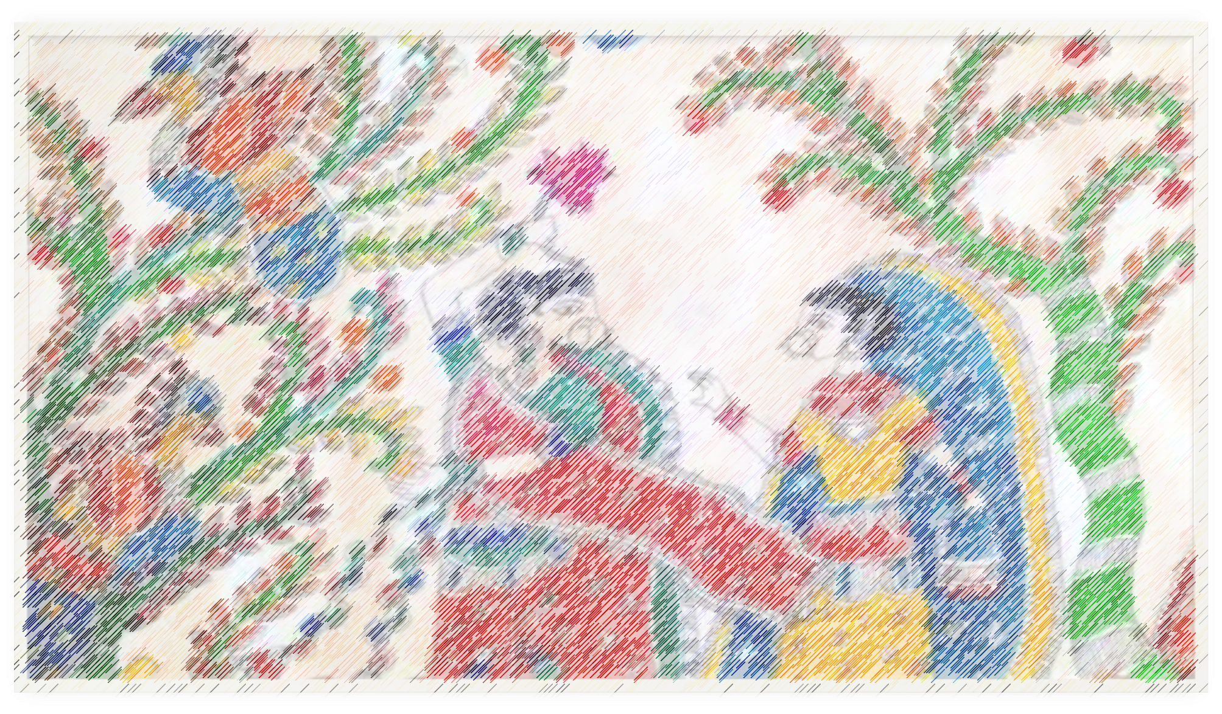
Art Integration & uploading of activities
-TOWARDS EXPERIENTIAL LEARNING
Central Board of Secondary Education

Slide 2

What is Art?
In the simplest words, art is the creative expression of an individual. This expression can be verbal, written. An enactment, or it can be visual, or any other form that has the potential or the ability to communicate human thoughts.
Why is Art important?
Artistic expression in music, poetry, dance theatre creation of forms has been an integral part human’s growth and development.

Slide 3

What do we mean by art integrated education?
It is a cross curricular approach to teaching and learning based on collaboration between the teaching of subjects with the learning of art (visual/performing etc.), where art in any of its multiple forms, becomes the primary pathway to learn the subjects/topic and also of assessment.
Why is art integration necessary in education?
The following words of Gurdev Rabindranath Tagore are possibly the best answer to this question. Says, “when I see the universe through my songs, I recognize it, only I know it.”
Firstly when art is integrates with education, it helps child to develop critical thinking and creativity for a deeper understanding of the concepts/topics.
Secondly, art integrated learning is a strong contender for experiential learning
Thirdly, this kind of integration makes the teaching and learning process joyful.
Fourthly, this integration broadens the mind of the students

Slide 4
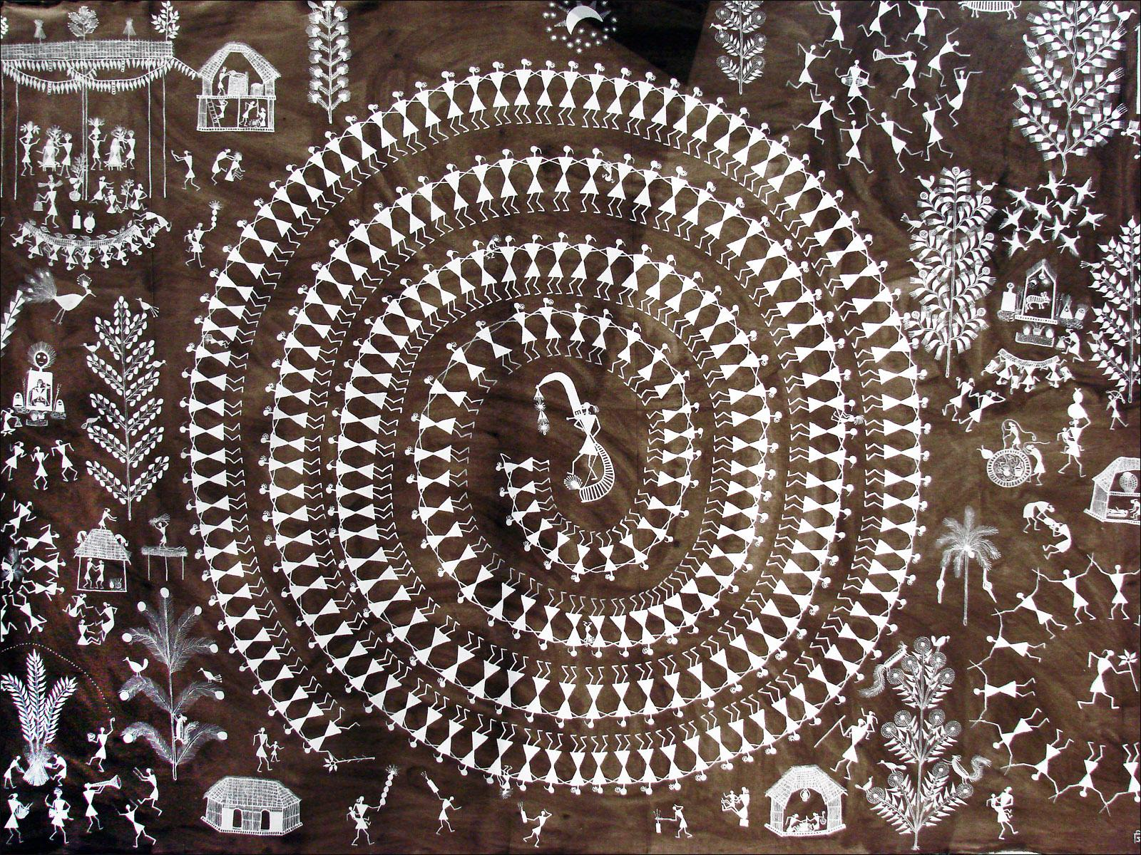
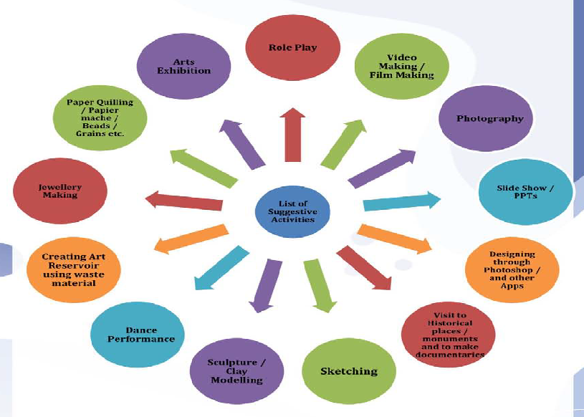

Slide 5

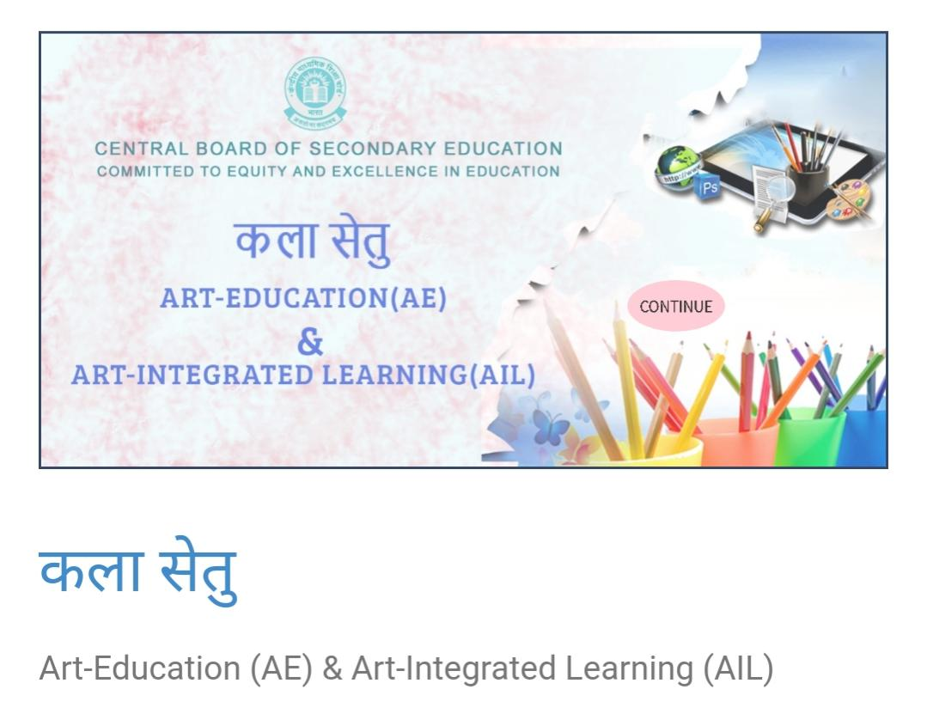

Slide 6
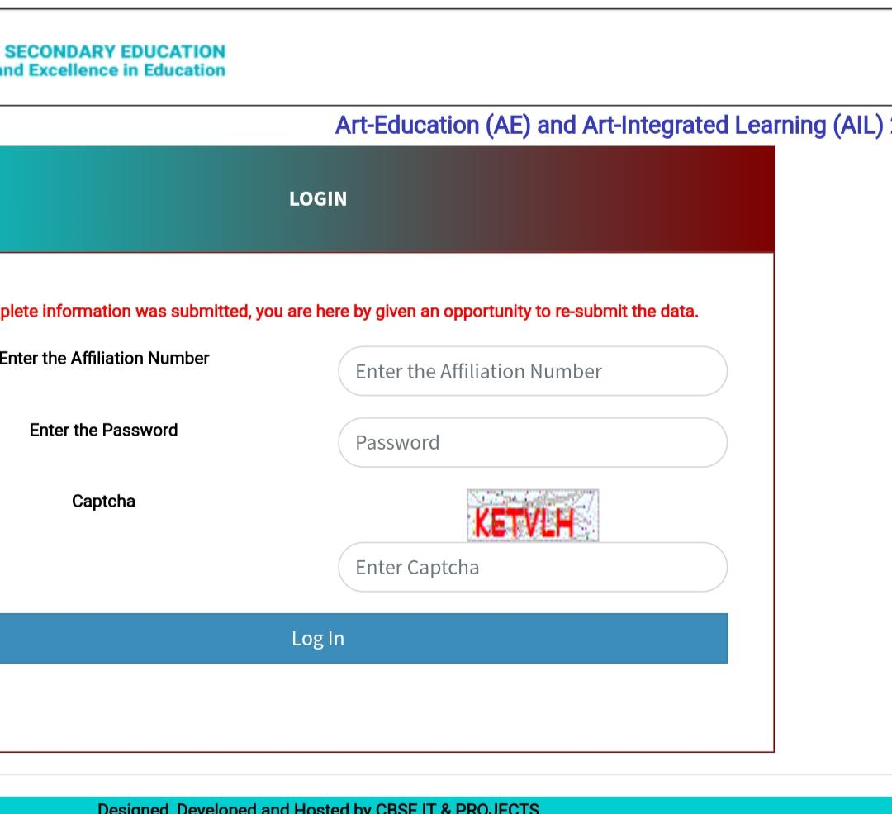

Slide 7
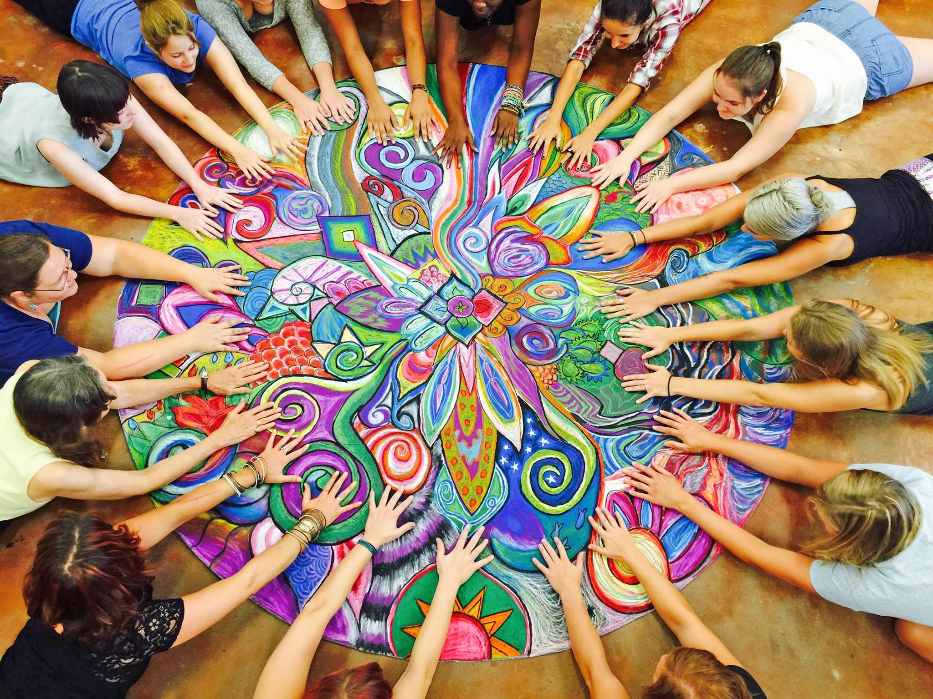


Slide 8
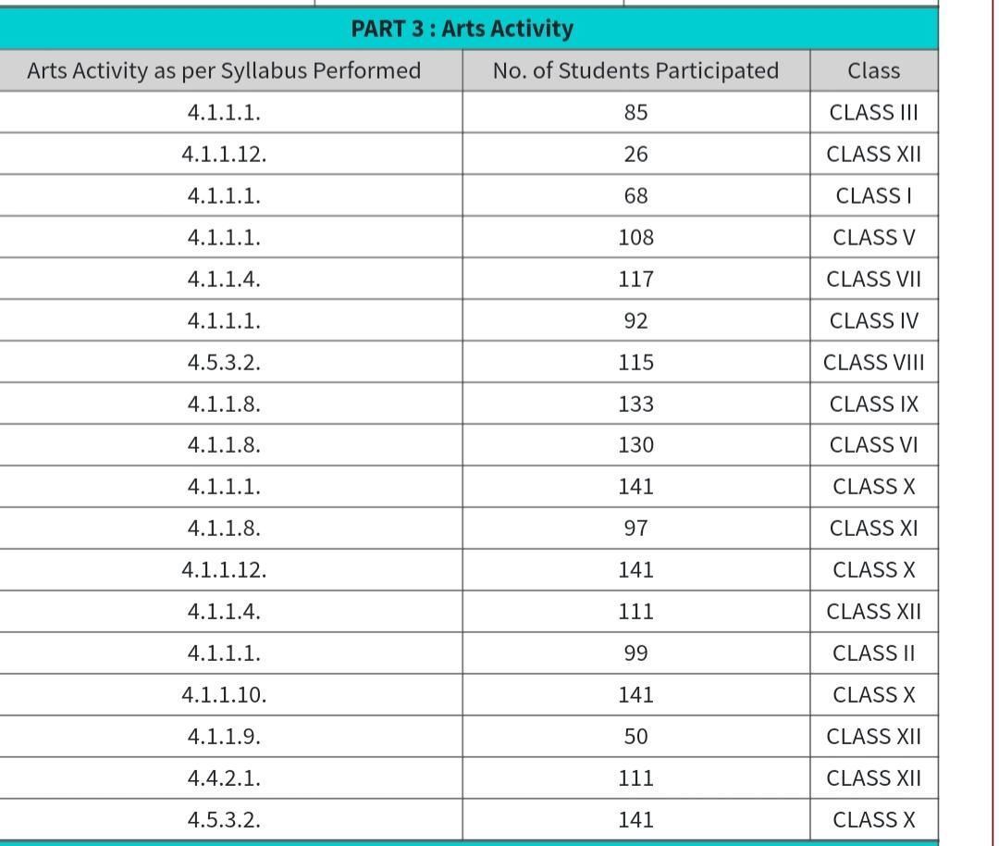

Slide 9
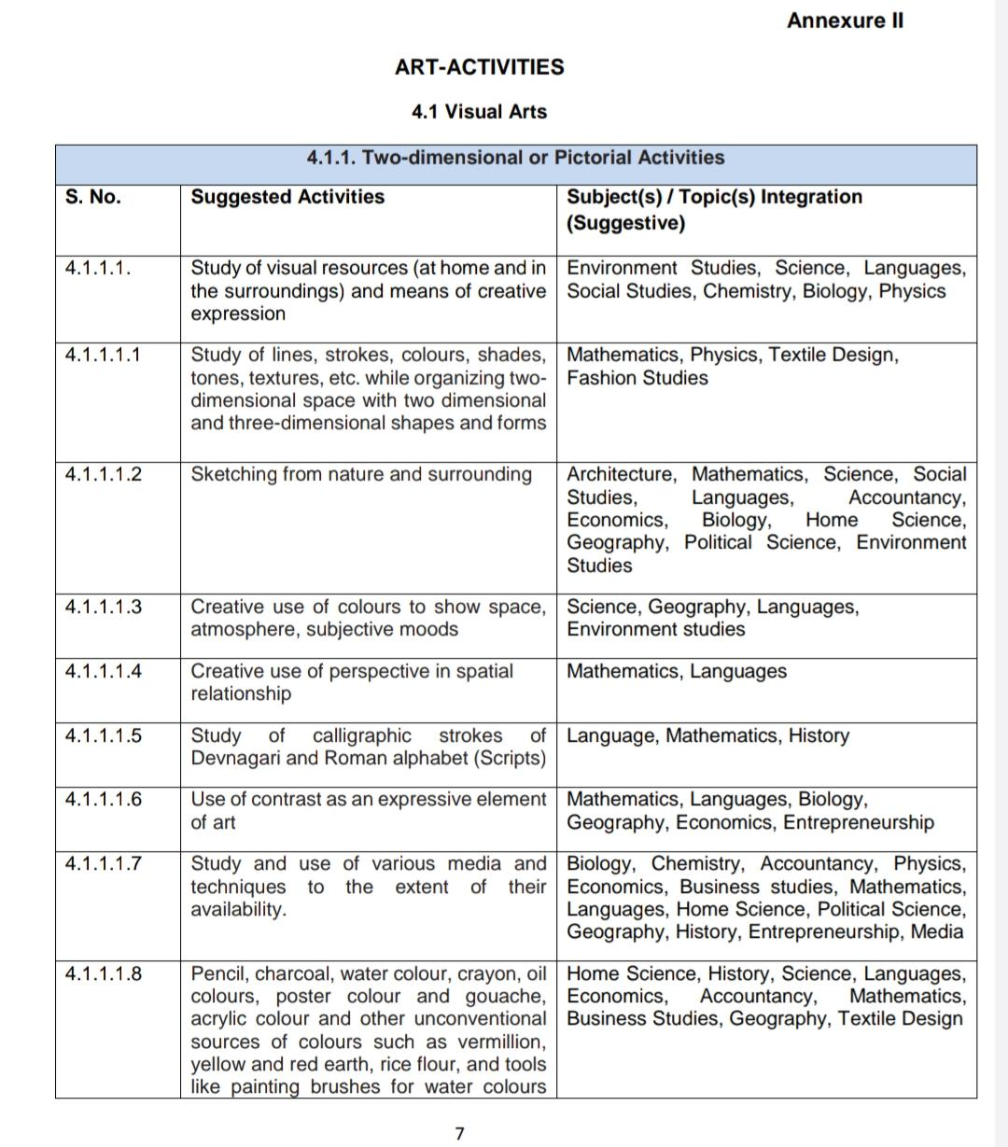
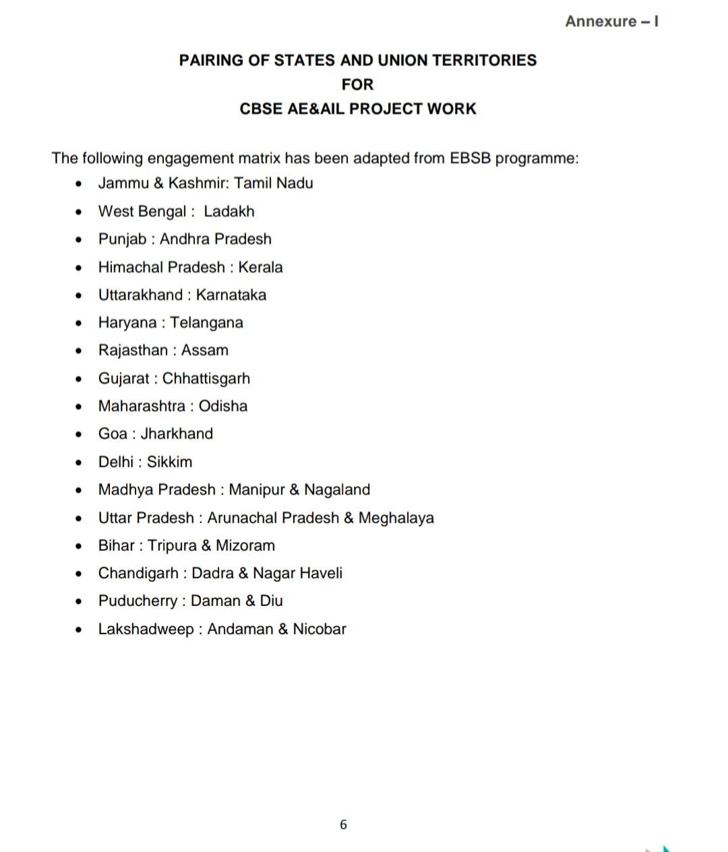

Slide 10
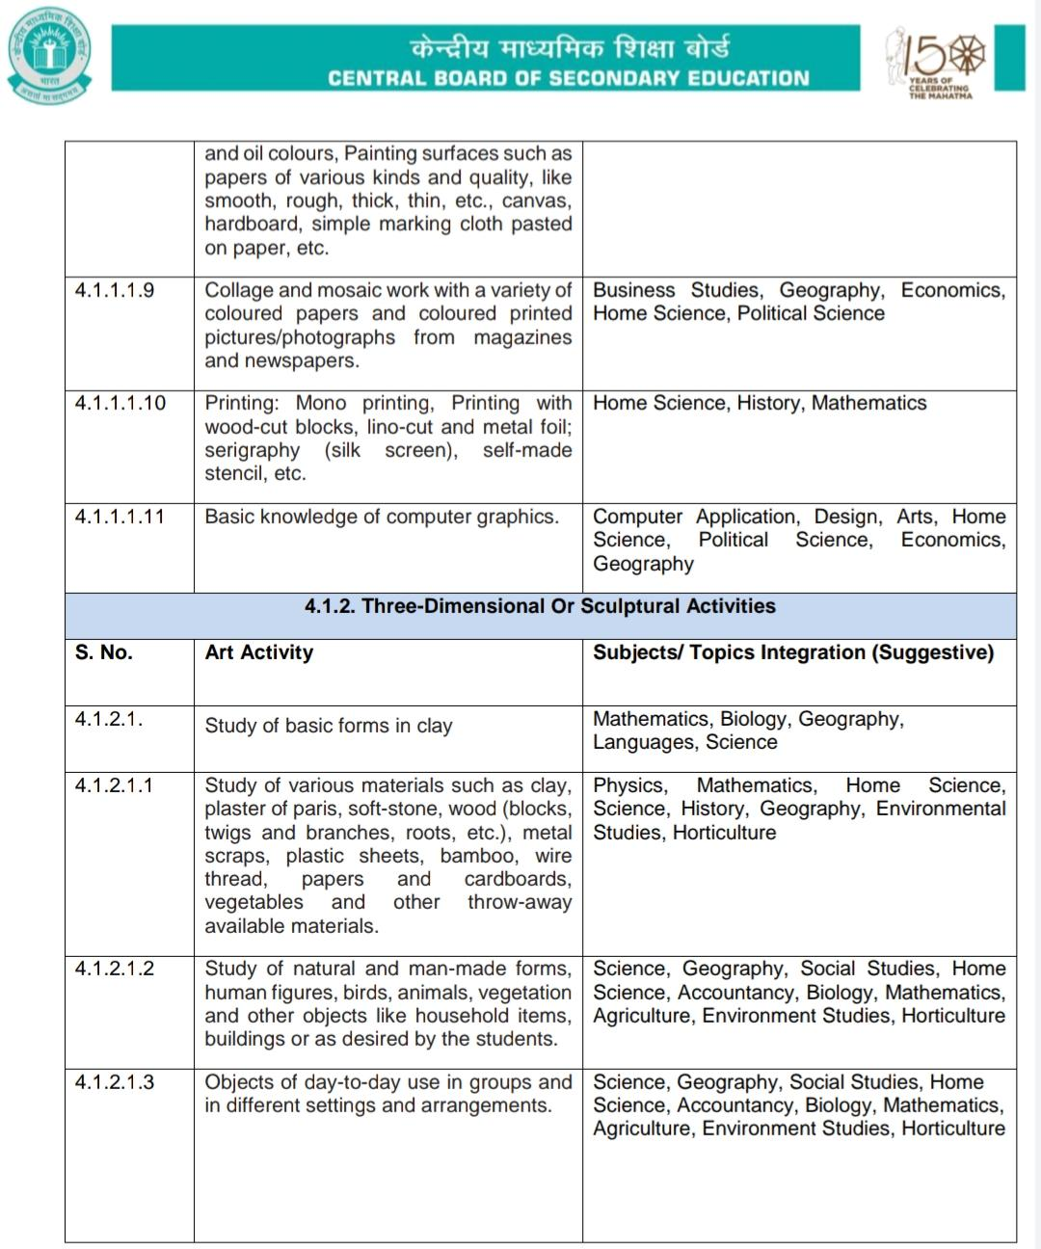
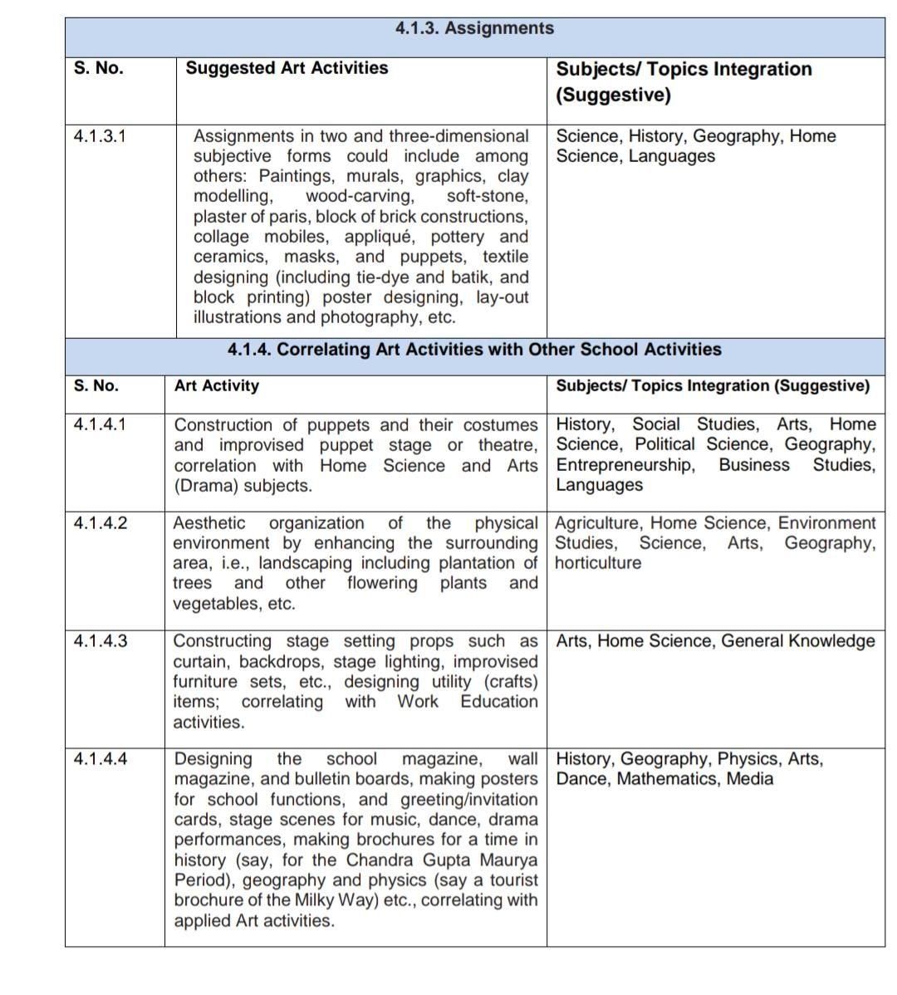

Slide 11

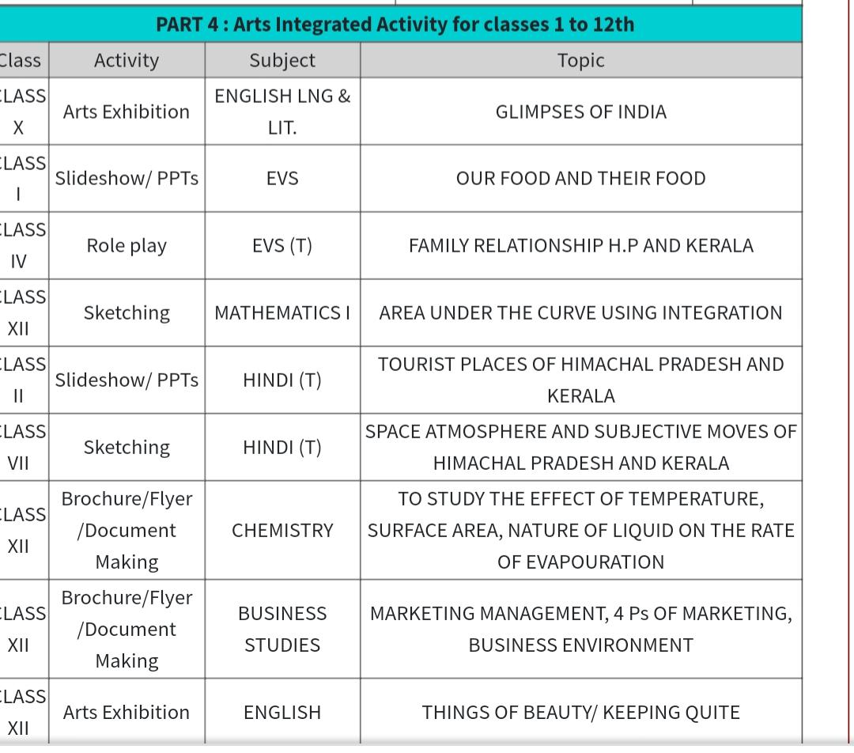
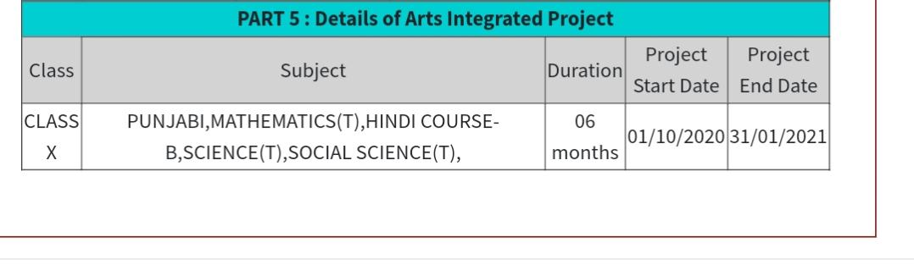

Slide 12
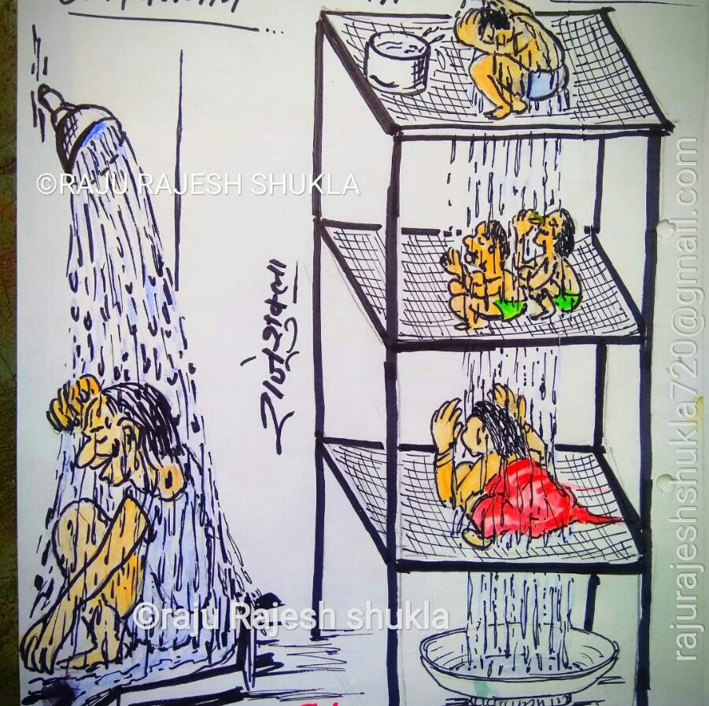
Thank you…

